Slide 1
Thesis Outlines
Abstract
Introduction
BC effect on radiative forcing
Model discrepancies due to arbitrary aging timescales
Method
Model Specifications
Modal aerosol model and monolayer criterion;
Aging timescales contributed by coagulation and condensation;
PartMC parameterization
Transfer rate from Modal

Slide 2
Plots
Plots
BC emissions(March and September for year 2010).
BC initial conditions.
Sensitivity on the number of monolayers (offline meteorology)
horizontal profiles
vertical profiles(source region & distant region & Arctic region)
Deposition Flux (dry & wet)
Mixing state analysis—SP2 papers, Volume fraction observed by SP2
Monolayer effect on radiative forcing (Arctic region)
Model v.s. PartMC aging timescales

Slide 3
Results
results:
Sensitivity analysis of BC burden
Simulated BC burden is most sensitive to the choices of aging criterion in the high-latitude regions, with maximum differences in the annually averaged BC mixing ratio of 16% near the surface.
BC vertical distributions show larger relative differences when it is further from the source regions. The differences can be the largest at high altitudes for some regions close to the Arctic.
The annual radiative forcing in the Arctic is higher when using 8 monolayers than using 1 monolayer by e.g. 20% (needs to be estimated).
Process analysis of BC aging.
Condensation of SOA and sulfate plays a dominating role.
Aging timescales range from less than one hour to several days.
MAM4 aging timescales broadly consistent with PartMC MOSAIC aging timescales.
When using an 8-monolayer sulfate criterion, the aging timescales have the closest linear-regression slope to 1 and the highest R² value among four sensitivity cases.
Comparing modeled BC burden with SP2 data
SP2 can capture most of BC in accumulation mode (internally mixed) when it is close to source regions.
In the Arctic, most of BC detected by SP2 measurements is externally mixed.
Notes:
Large discrepancies in the upper level compared with HIPPO. We need to figure out what processes contribute that differences.

Slide 4
BC emission files
Time:
2010-03 and 2010-09
BC surface emissions:
/glade/p/cesmdata/cseg/inputdata/atm/cam/chem/trop_mozart_aero/emis/ar5_mam3_bc_surf_1850-2010_c20100902_v12.nc
agricultural waste burning emissions
domestic emissions
energy emissions
industry emissions
transportation emissions
waste treatment emissions
ship emissions
BC elevated emissions
/glade/p/cesmdata/cseg/inputdata/atm/cam/chem/trop_mozart_aero/emis/ar5_mam3_bc _elev_1850-2010_c20100902_v12.nc
BC forest fire emissions:
IPCC_GriddedBiomassBurningEmissions_BC_decadalmonthlymean1850_v1.nc
BC grass fire emissions:
IPCC_GriddedBiomassBurningEmissions_BC_decadalmonthlymean1850_v1.nc

Slide 5
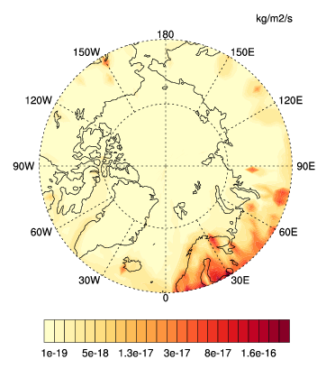
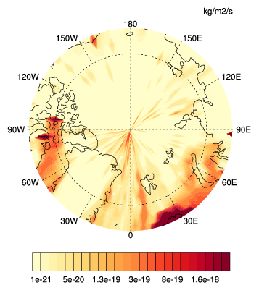
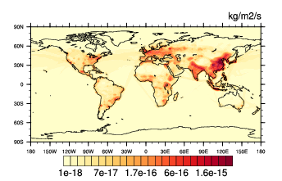
BC surface emissions – Annual – Surface – year 2010
> 60N
> 70N

Slide 6
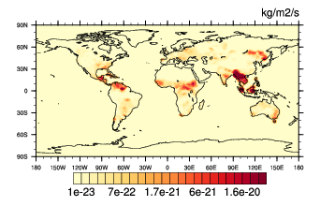
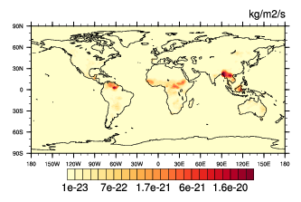
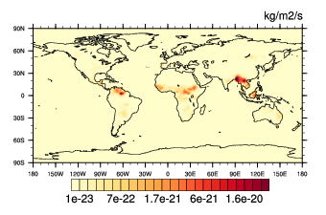
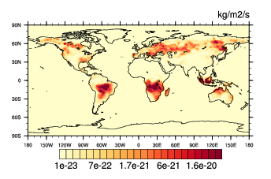
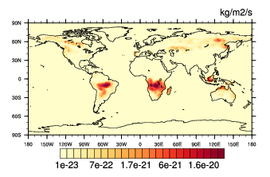
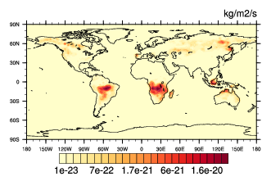
BC elevated emissions – Fire – year 2010
0-126m
278-454m
654-879m
March
September

Slide 7
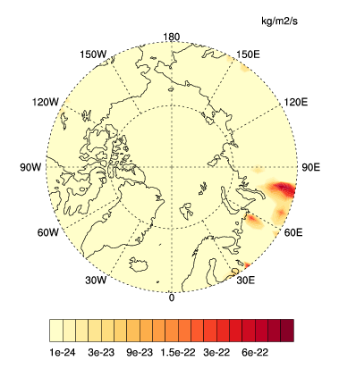
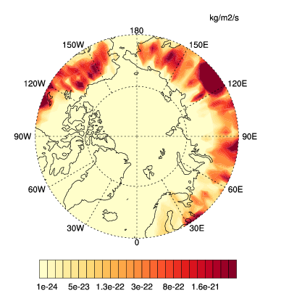
BC elevated emissions – Fire – year 2010
March September

Slide 8
BC Initial Conditions
/glade/p/cesm/cseg//inputdata/atm/cam/inic/fv/camchem_ic_2008-01-01_1.9x2.5_L56_c110118.nc
BC does not appear in the initial file when we use offline meteorology, but it does appear in the initial file when we use online meteorology.

Slide 9
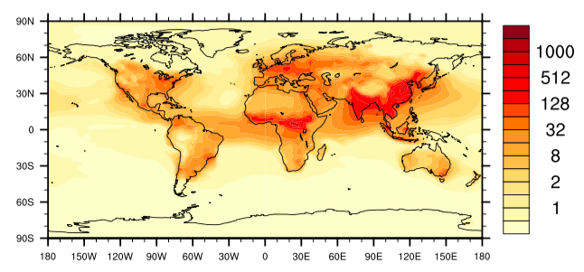
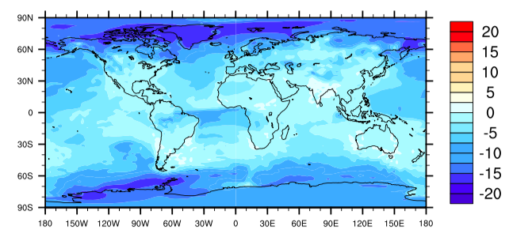
Annual BC Mixing Ratio and Relative Differences
L8
(L1-L8)/L8

Slide 10
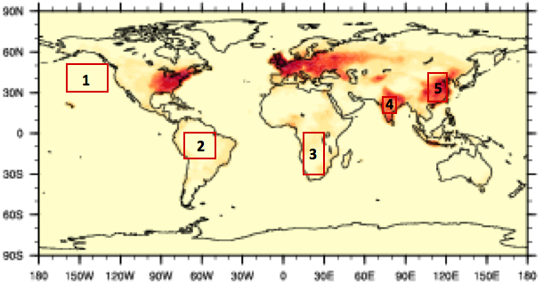
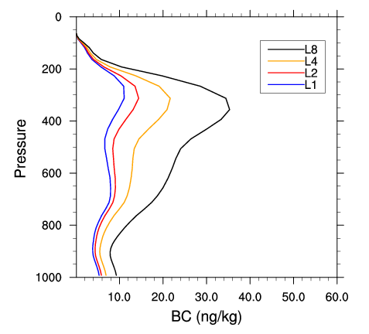
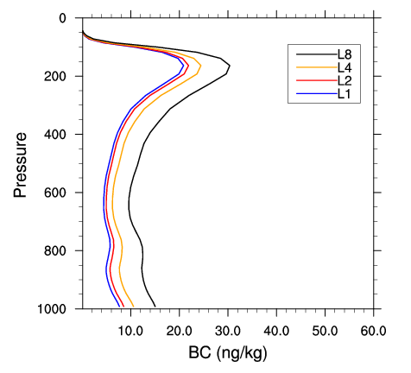
Region 1
March
September

Slide 11
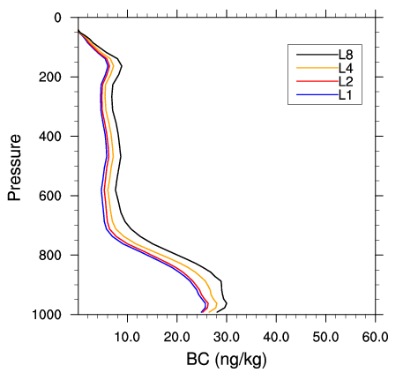
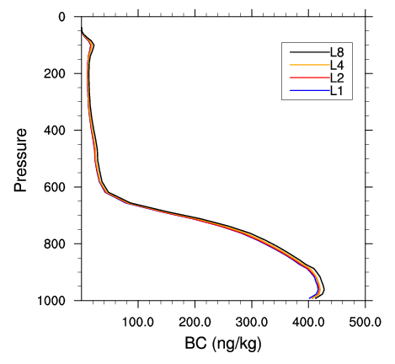
Region 2
March
September

Slide 12
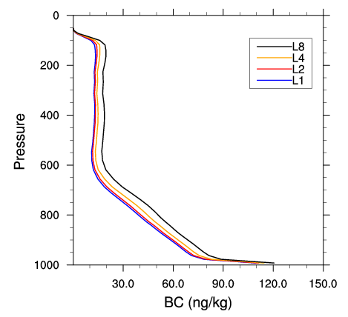
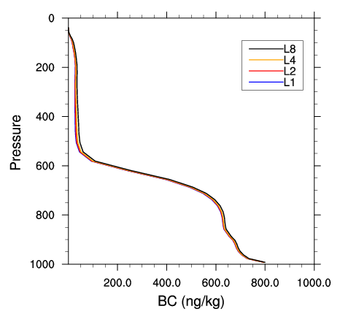
Region 3
March
September

Slide 13
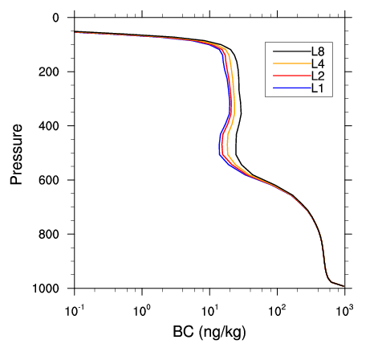
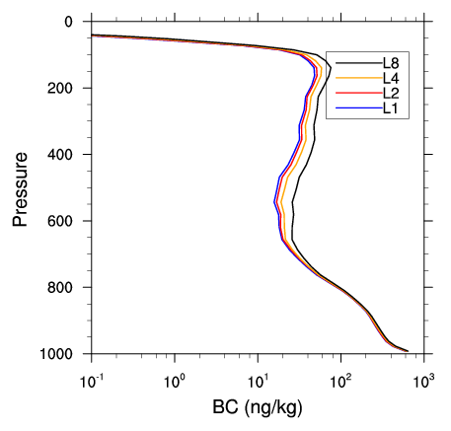
Region 4
March
September

Slide 14
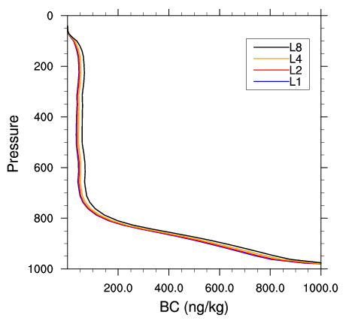
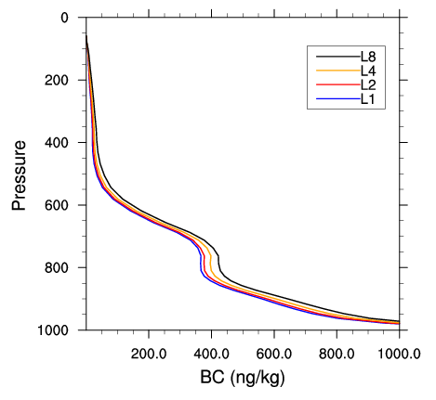
Region 5
March
September

Slide 15
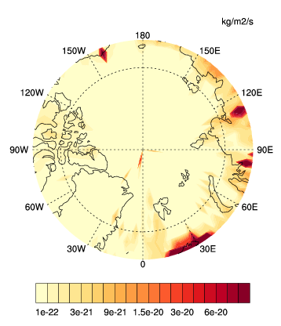
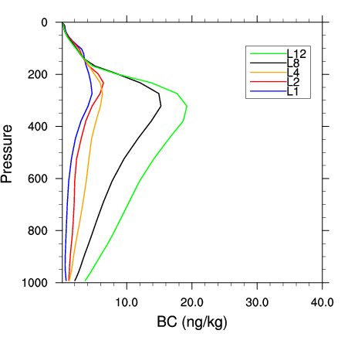
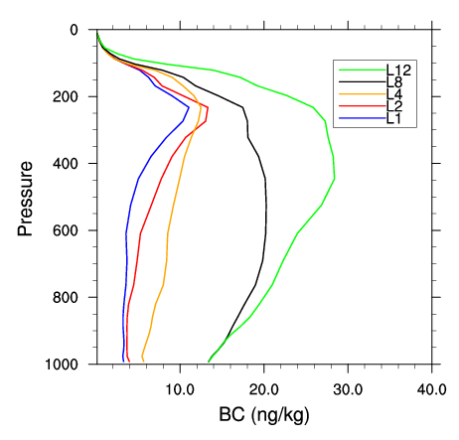
Arctic (average over the pole?)
March September

Slide 16
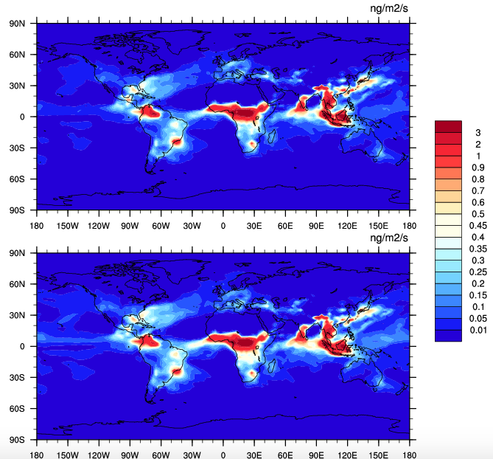
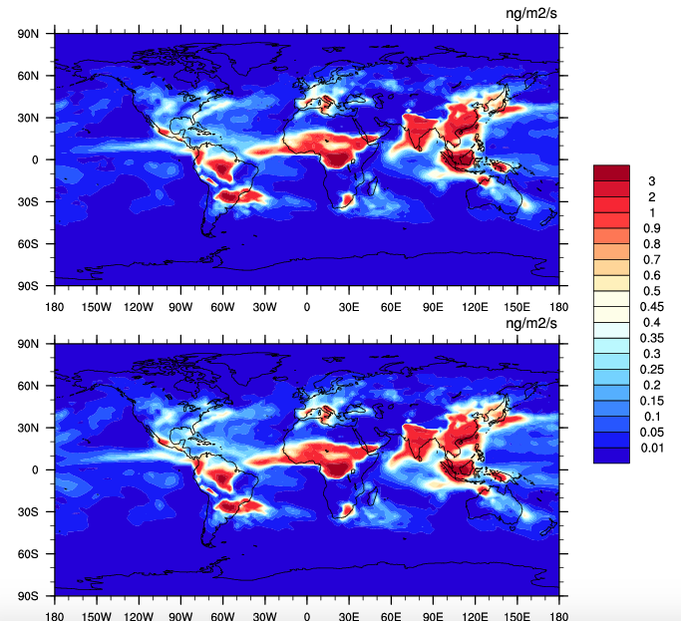
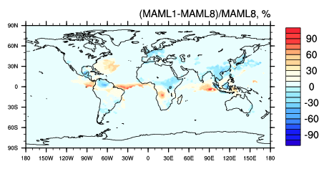
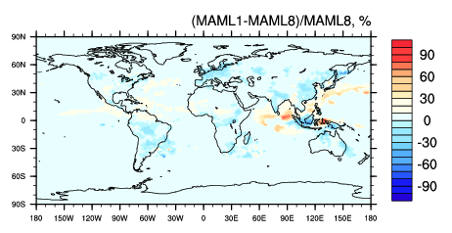
BC Wet Deposition Flux – happens only in accumulation mode
March
September
L1
L8
Relative
Differences
(L8-L1)/L8

Slide 17
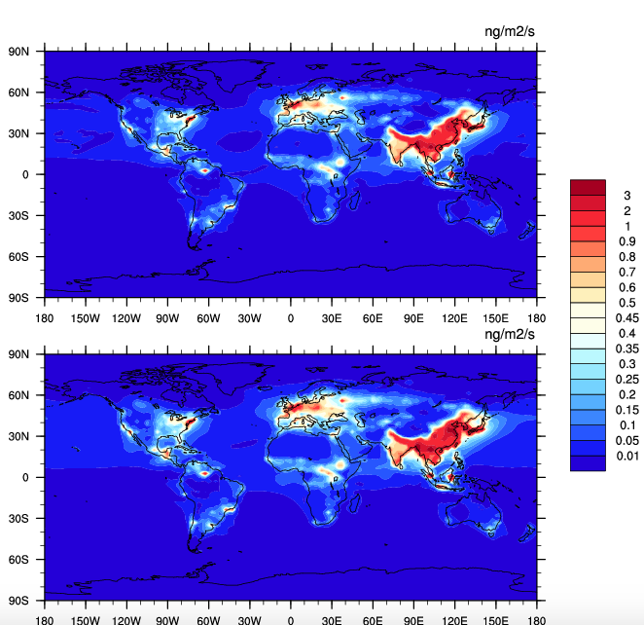
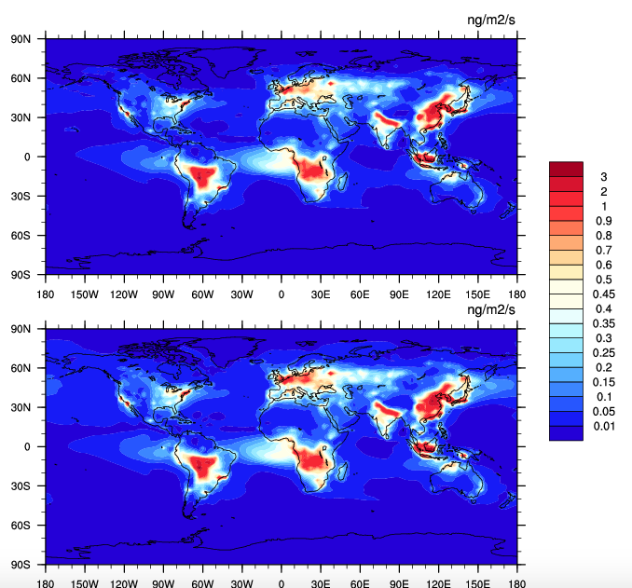
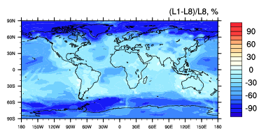
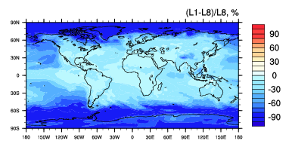
BC Dry Deposition Flux
March
September
L1
L8
Relative
Differences
(L8-L1)/L8

Slide 18
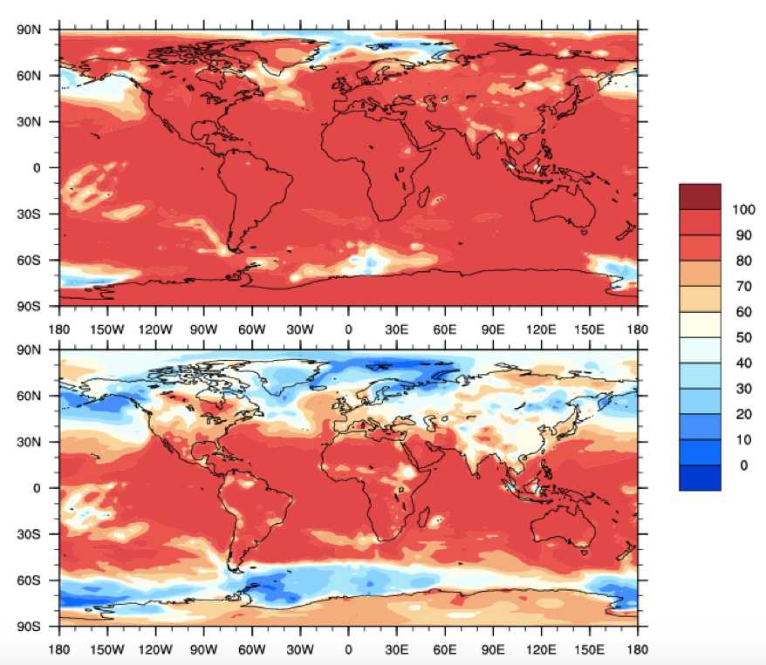
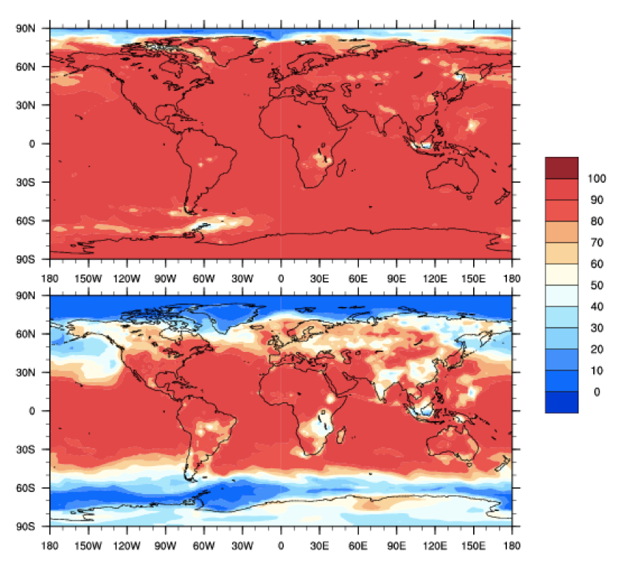
BC Ratio: Accumulation/Total – 992hPa
March September
L1
L8

Slide 19
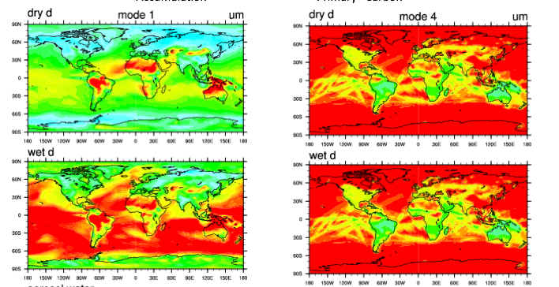
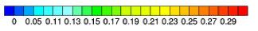
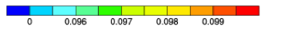
Interstitial Aerosol Diameter – 992hPa, March
Accumulation Primary Carbon

Slide 20
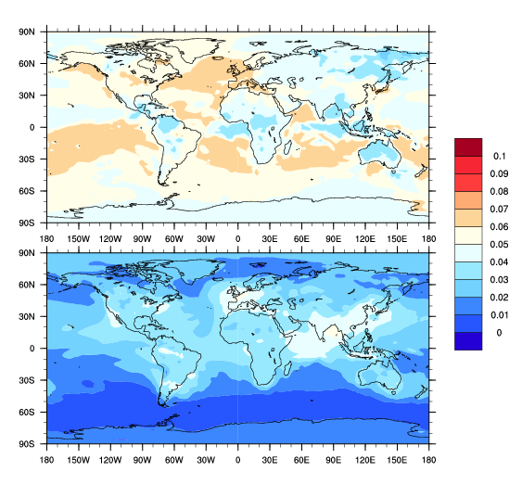
Geometric Mean Diameter - March
Accumulation mode
Primary carbon mode
um

Slide 21
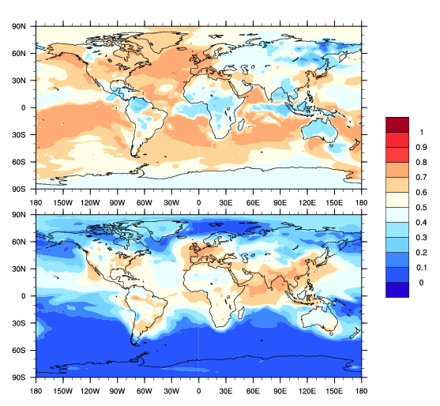
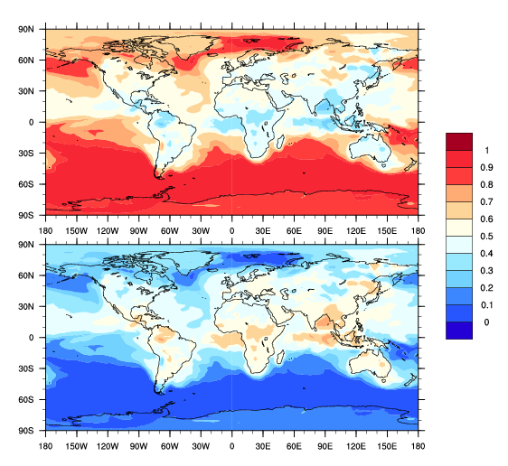
For comparison with SP2 measurements need to focus on diameter range 90 nm - 400 nm
Mass Fraction Corresponding to SP2 Measurement Range (90nm – 400 nm) March (using offline meteorology) – 992hPa
Accumulation mode
Primary carbon mode
Accu(90-400)/total Accu
Accu(90-400)/total(90-400)
%
%
Pc(90-400)/total Pc
Pc(90-400)/total(90-400)

Slide 22
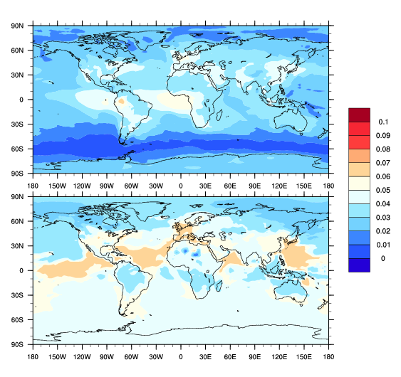
Geometric Mean Diameter - September
Accumulation mode
Primary carbon mode
um

Slide 23
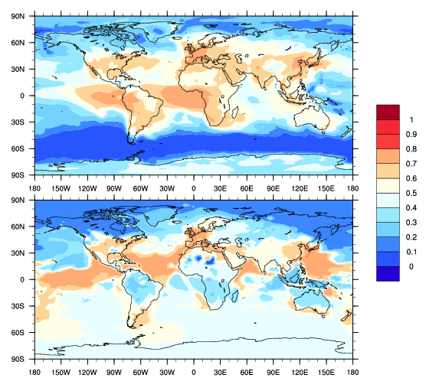
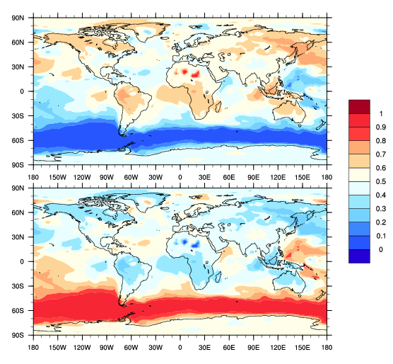
For comparison with SP2 measurements need to focus on diameter range 90 nm - 400 nm
Mass Fraction Corresponding to SP2 Measurement Range (90nm – 400 nm) September (using offline meteorology) – 992hPa
Accumulation mode
Primary carbon mode
Accu(90-400)/total Accu
Accu(90-400)/total(90-400)
%
%
Pc(90-400)/total Pc
Pc(90-400)/total(90-400)

Slide 24
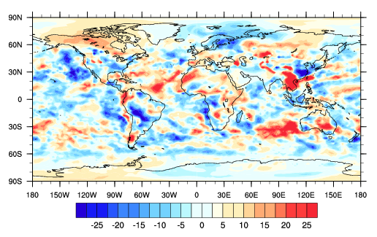
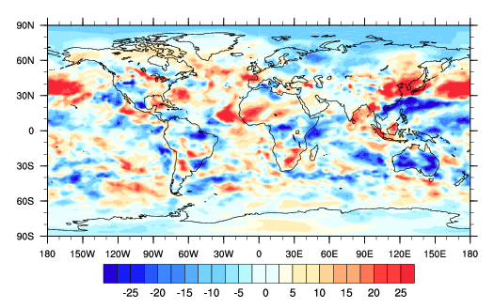
Radiative forcing (net solar shortwave – net longwave at the top of the model)---March
8-monolayer
1-monolayer

Slide 25
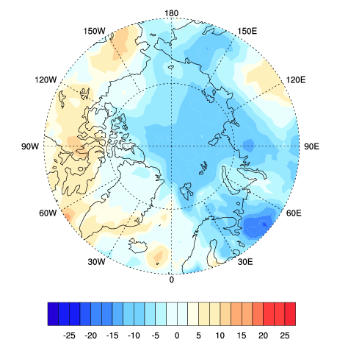
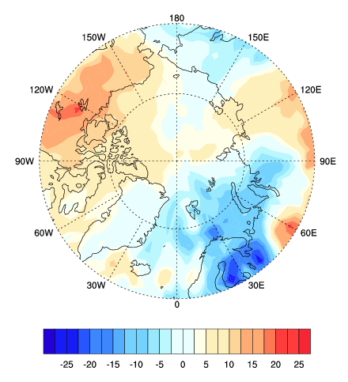
Polar Map for Arctic Region -- March
8-monolayer
1-monolayer
W/m2
W/m2

Slide 26


Radiative forcing (net solar – net longwave at the top of the model)---September
8-monolayer
1-monolayer
W/m2
W/m2
Average: 0.46 W/m2
Average: -1.44 W/m2
Notes:
Now running for one year.

Slide 27


Polar Map for Arctic Region -- September
8-monolayer
1-monolayer
W/m2
W/m2

Slide 28


Annual Radiative Forcing
8-monolayer
1-monolayer
Mean: 0.1831706 W/m2
Mean: 0.4841237 W/m2

Slide 29
Polar Map for Arctic Region - Annual
1-monolayer
8-monolayer
W/m2
W/m2

Slide 30
Comparison of Aging Timescales from CAMchem and Laura’s Parameterization
Timescale of BC aging based on PartMC-MOSAIC simulations (Fierce et al., BAMS 2016):
condensation coagulation
I_{cond}: total volume condensation rate over surface area
N: total aerosol number concentration
CAMChem:

Slide 31




Condensation Volume Rate over Surface Area -computed from mode 4
Volumn_rate: m^3/kmol air/s
Surface_area: (#/kmol air)*m^2)
I_cond: ((m^3/kmol air/s)/((#/kmol air)*m^2))=m/s
March September
992hPa
859hPa

Slide 32

Contribution from Condensation and Coagulation March, 992 hPa
CAMChem
PartMC Parameterization
Condensation
Coagulation
Overall
Condensation plays a dominating role.
Aging timescales range from less than one hour to several days.

Slide 33

Contribution from Condensation and Coagulation March, 857 hPa
CAMChem
PartMC Parameterization
Condensation
Coagulation
Overall
Condensation plays a dominating role.
Aging timescales range from less than one hour to several days.

Slide 34

Contribution from Condensation and Coagulation September, 992 hPa
CAMChem
PartMC Parameterization
Condensation
Coagulation
Overall

Slide 35

Contribution from Condensation and Coagulation September, 857 hPa
CAMChem
PartMC Parameterization
Condensation
Coagulation
Overall
Condensation plays a dominating role.
Aging timescales range from less than one hour to several days.

Slide 36

Contribution from Condensation and Coagulation Annual, 992 hPa
CAMChem
PartMC Parameterization
Condensation
Coagulation
Overall
Condensation plays a dominating role.
Aging timescales range from less than one hour to several days.

Slide 37

Contribution from Condensation and Coagulation Annual, 857 hPa
CAMChem
PartMC Parameterization
Condensation
Coagulation
Overall
Condensation plays a dominating role.
Aging timescales range from less than one hour to several days.

Slide 38

Scatter Plot of Annual mean aging timescales – 992hPa (Plan to do more monolayer sensitivity tests.)
L1
L2
L4
L8

Slide 39
Ongoing tasks
Sensitivity tests using 6 and 12 monolayers, make scatter plots for upper layer.
Check the sp2 papers about the mixing states of BC.
Look into BC burden at diff levels for Arctic region
Plot the same vertical profiles for HIPPO regions
Ask Dubey sp2 measurements in the Arctic
Write method part.
Do a histogram of the growth rates
Send data to Laura

Slide 40
L1
L2
L4
L6
L8
Scatter Plot of Annual mean aging timescales – 992hPa (Plan to do more monolayer sensitivity tests.)

Slide 41
L1
L2
L4
L6
L8
Scatter Plot of Annual mean aging timescales – 857hPa (Plan to do more monolayer sensitivity tests.)

Slide 42






992 hPa
917 hPa
857 hPa
810 hPa
737 hPa
656 hPa
Notes:
55, 50, 46, 43, 40

Slide 43







Jan 2011
Jan 2009

Slide 44






Slide 45
Add background (BC mixing in the Arctic).
Method:
How modal model works.
(By next Thursday!)
Check papers about BC in the upper arctic
Double check the condensation rate (a factor of 10..), try average over an hour

